Slide 1
Deep learning project
Danah, Ahmad , Raghad , Hanan

Slide 2
Aim
To build a Convolutional Neural Network (CNN) model to classify images from CIFAR10 dataset into predefined categories

Slide 3
Data Preprocessing

Slide 4
Data Preprocessing
Libraries | Download the necessary libraries
Data | Download the CIFAR 10 datasets
Normalization | Scale the pixel values of images to [0,1]
Resizing | Change the dimentions of image to a fixed size
Augmentation | Applies random transformation ex: (rotation, Flipping)
Visualization | To ensure the data has been loaded and preprocessed correctly

Slide 5
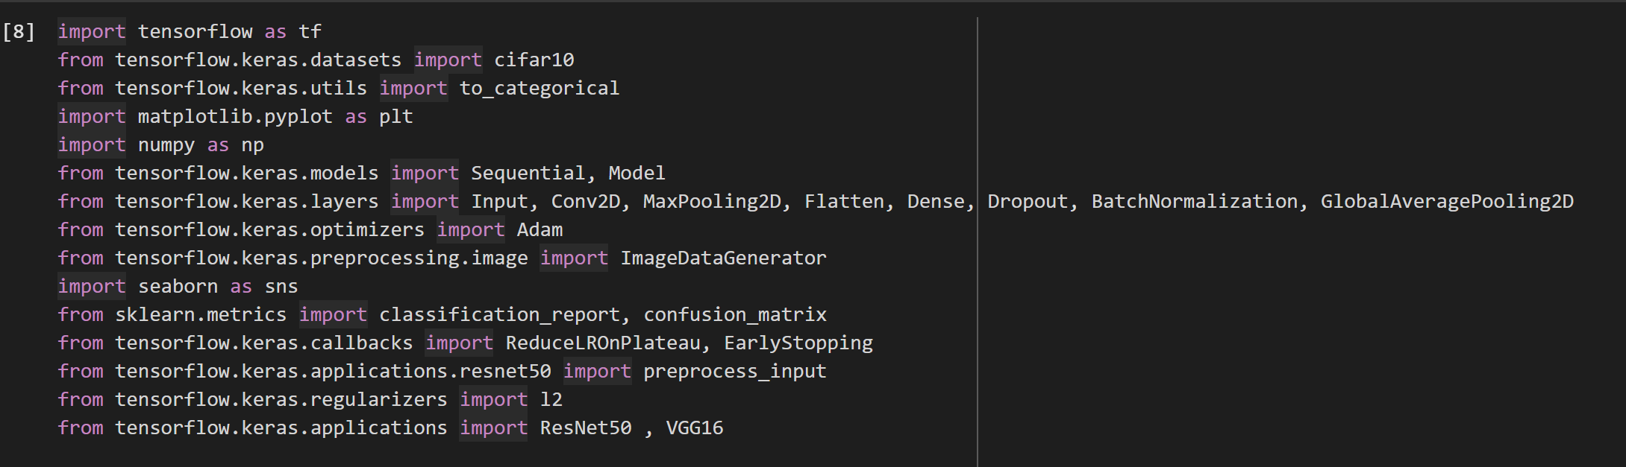
Download the libraries

Slide 6
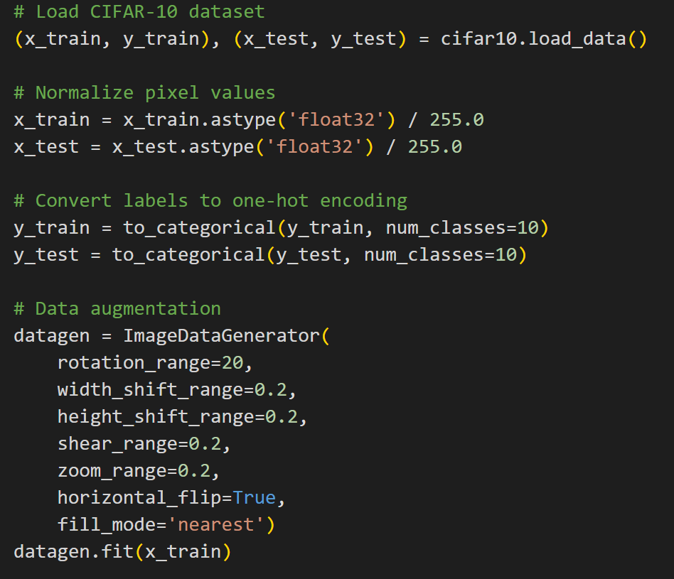
Load the data Normalization Augmantation

Slide 7
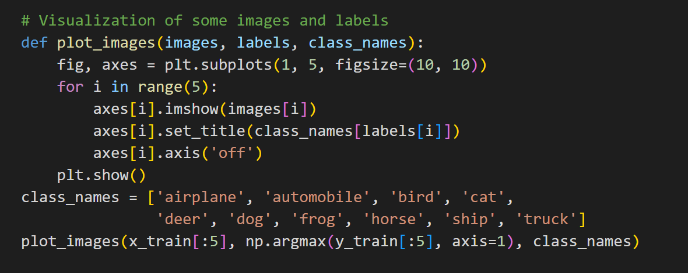
Visualization of the data

Slide 8
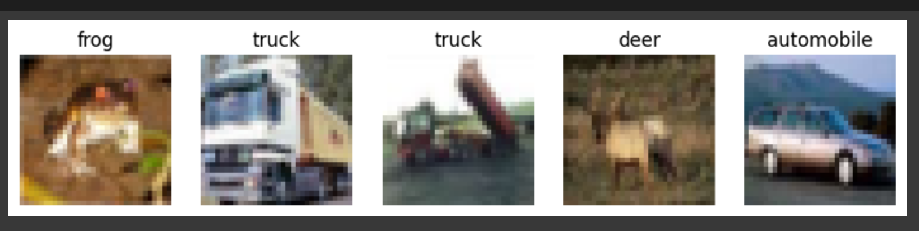
Output of Data Visualization

Slide 9
Model Architecture

Slide 10
Model Architecture
Pooling | Makes the model less sensitive to small shifts in the input parameters and controls overfitting.
Droupout | randomly deactivates a fraction of neurons during training, preventing the model from relying too heavily on specific neurons.
Activation function (ReLU, Softmax) | gives the model the ability to learn complex relashionships and Ensures gradients can flow during backpropagation

Slide 11
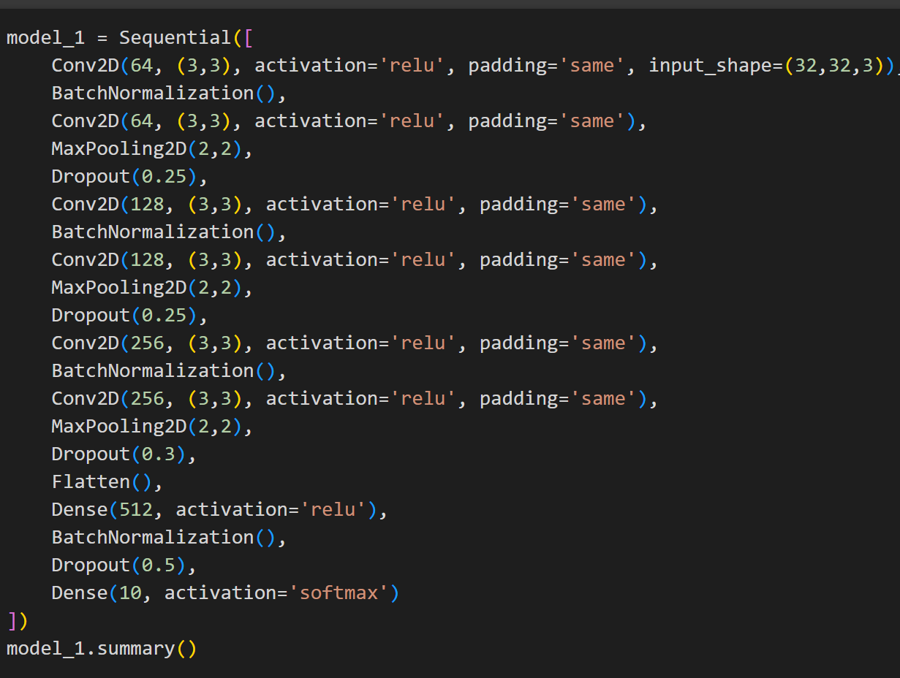
Model 1
CNN Layers

Slide 12
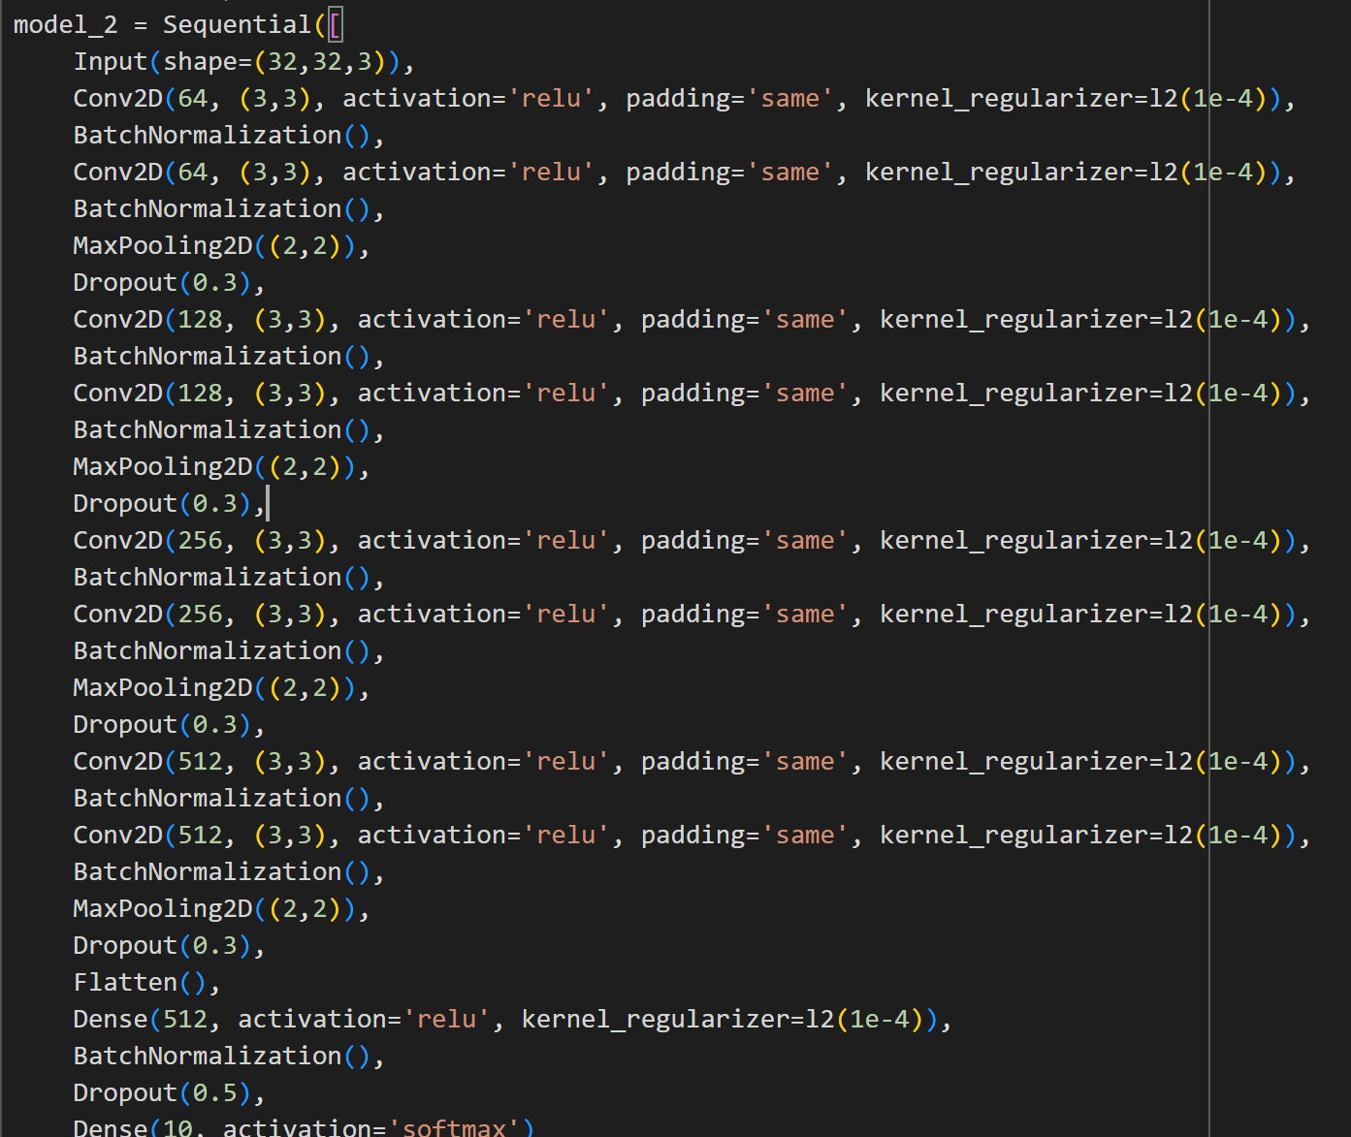
Model 2
CNN Layers

Slide 13
Model Training

Slide 14
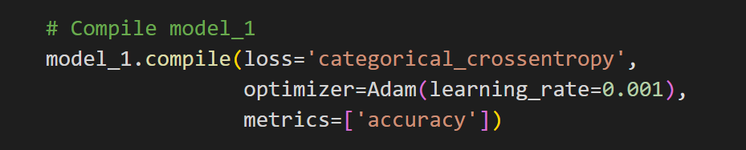
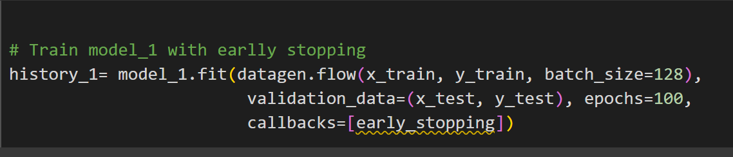
Compile:
prepares the model for training by specifying the loss function, optimizer, and evaluation metric.
Train the model

Slide 15
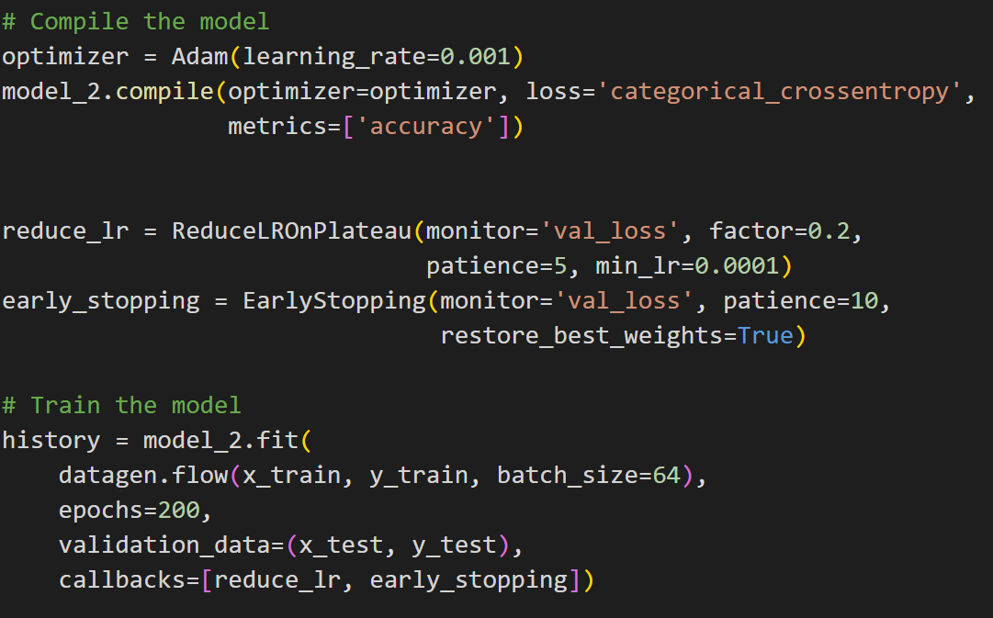
Model 2
1- We added a learning rate schedule which automatically reduces the learning rate when the model stops improving during training.
2-reduce the batch size & increase the epochs

Slide 16
Model Evaluation

Slide 17
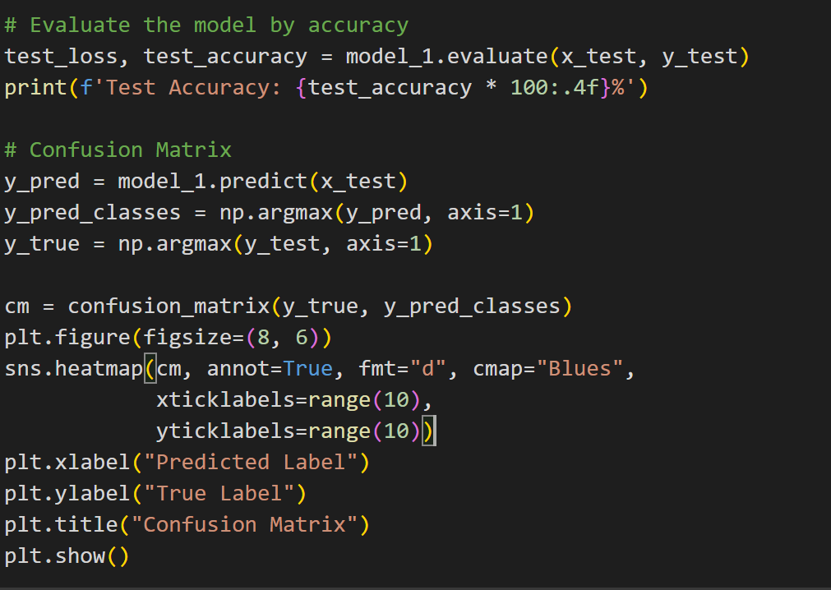
Evaluate the model by :
Accuarcy
Confusion matrix

Slide 18
Accuracy
Model 1
Model 2
86.68%
91.58%

Slide 19
Transfer Learning

Slide 20
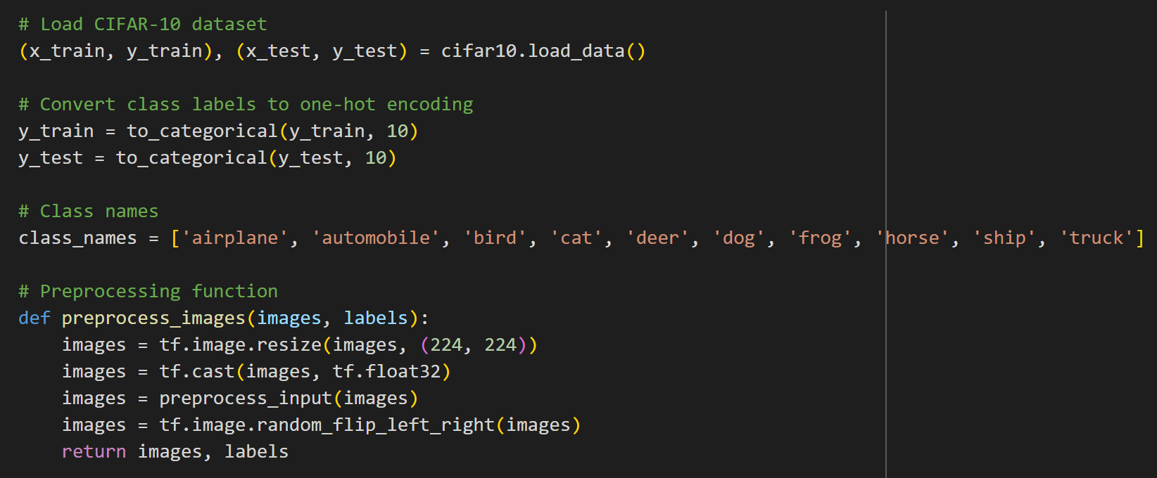
Download the Data &Preprocess it for Transfer Learning models

Slide 21
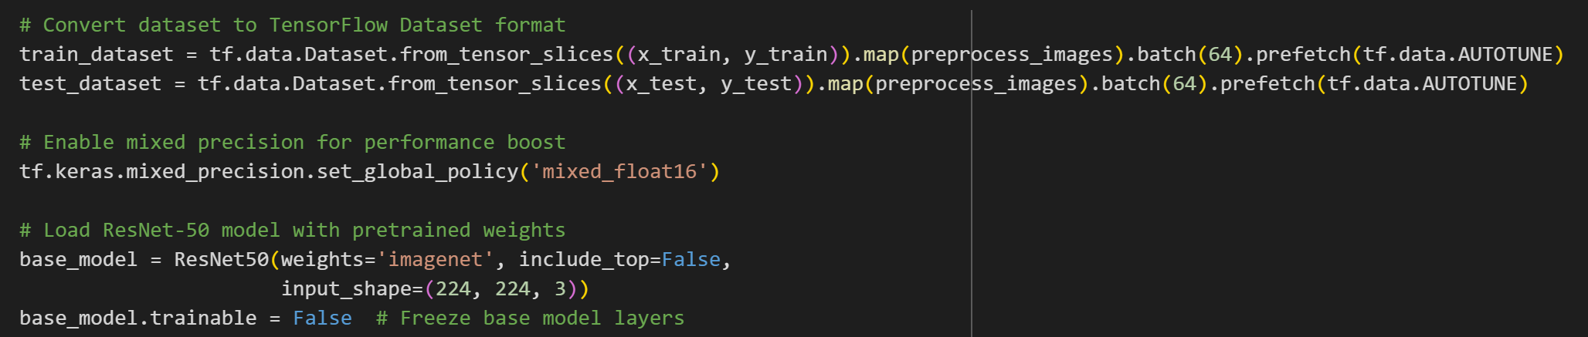
- converts data to TensorFlow dataset for faster loading - enables mixed-precision training (float16) to improve performance and reduce memory usage. -load the ResNet model

Slide 22
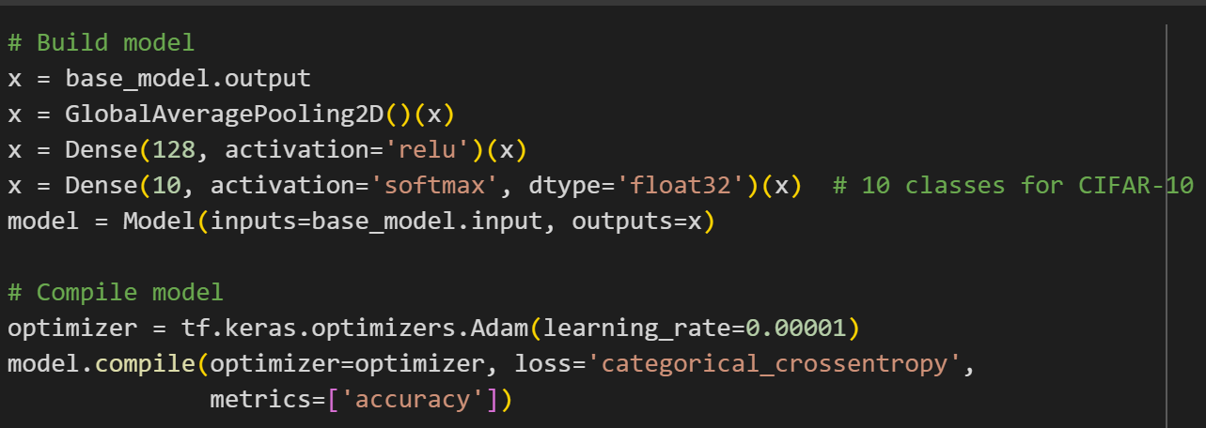
Build & prepare the model for training

Slide 23
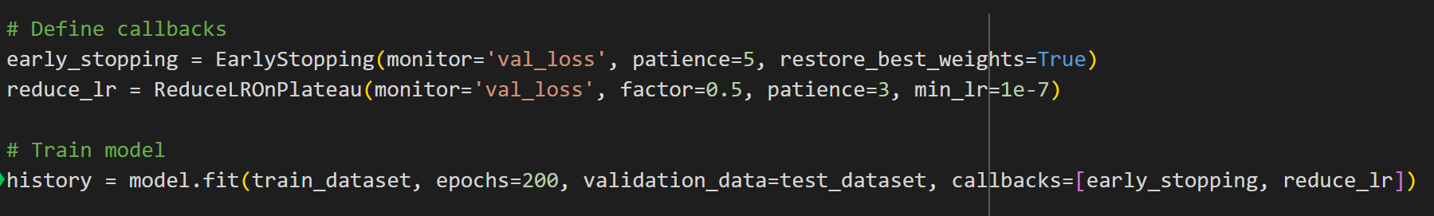
Train the model

Slide 24
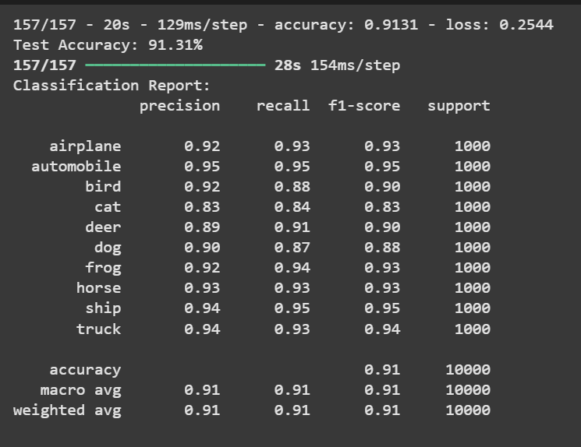
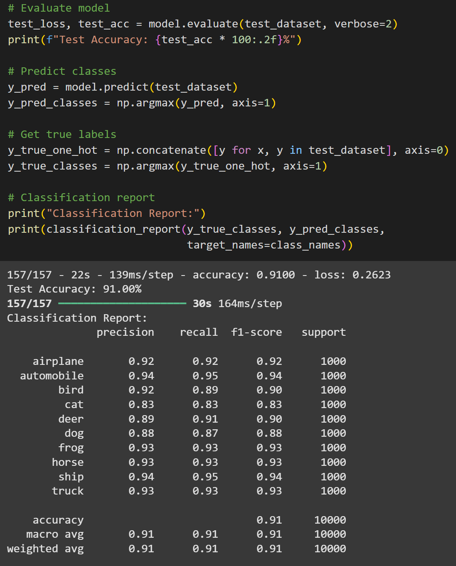
ResNet 50 Evaluation

Slide 25
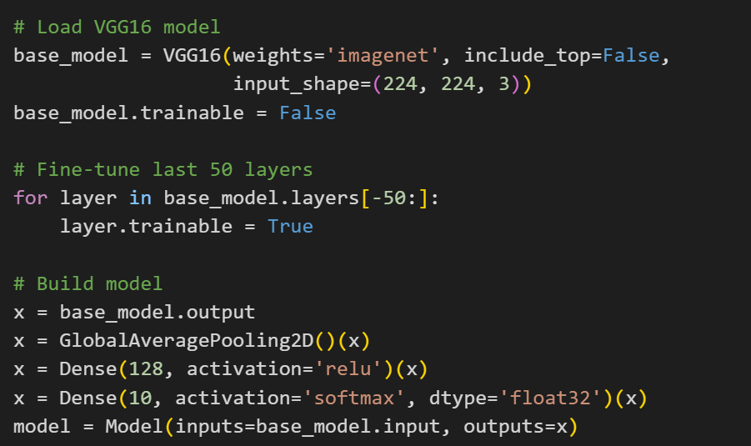
Load the VGG16 model & build it

Slide 26
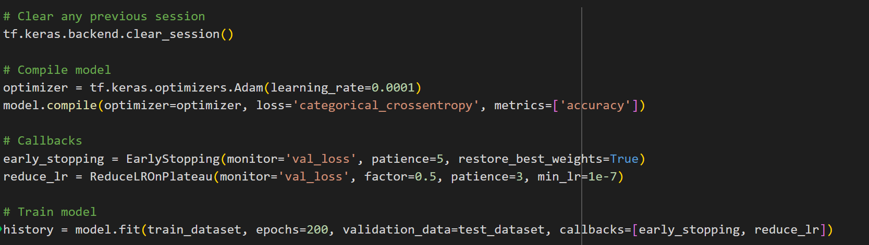
Prepare & Train the model

Slide 27
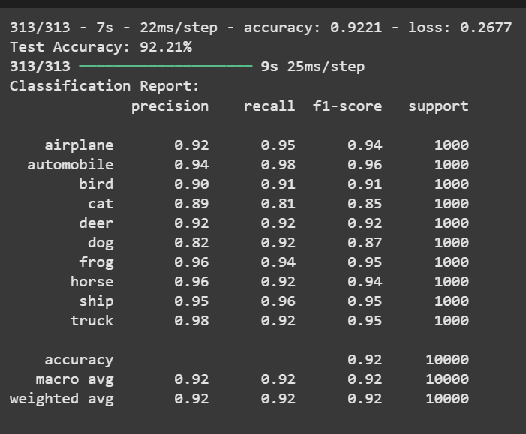
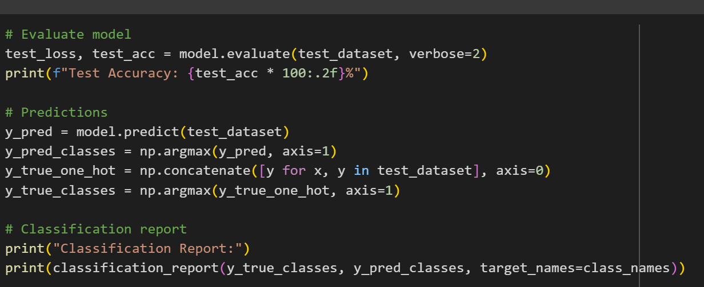
VGG16 Evaluation

Slide 28
Models Comparison

Slide 29
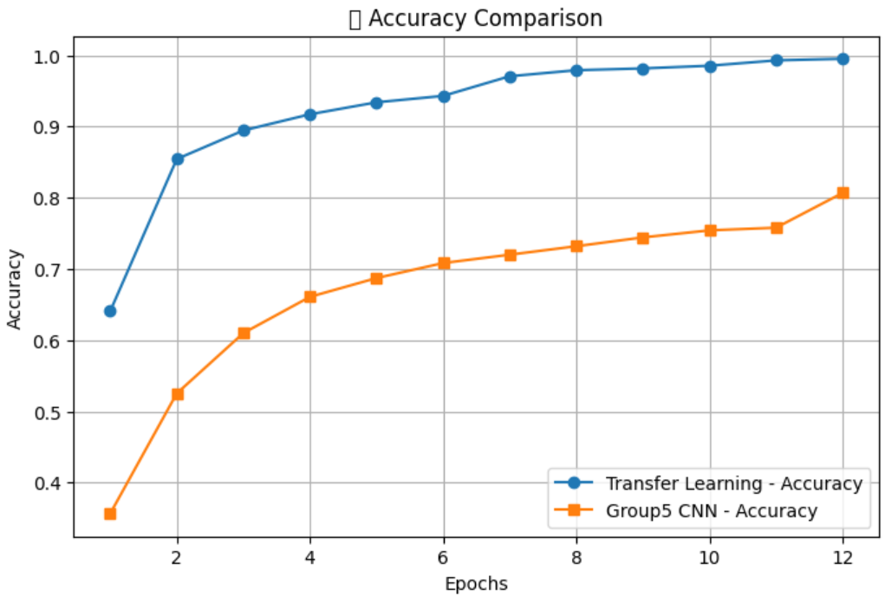
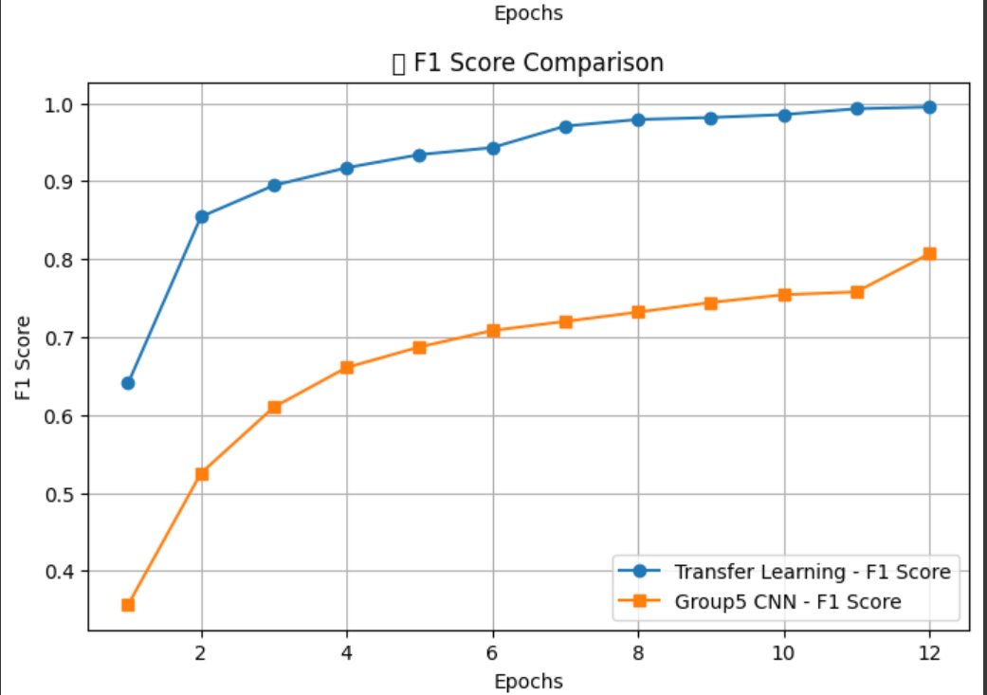

Slide 30
Model deployment

Slide 31
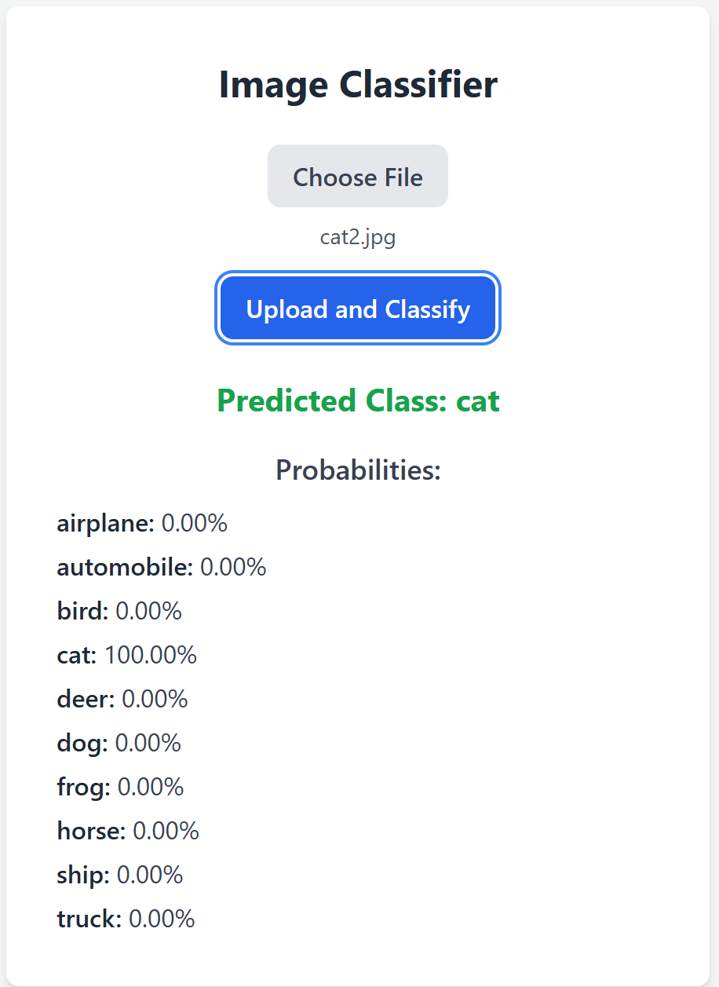
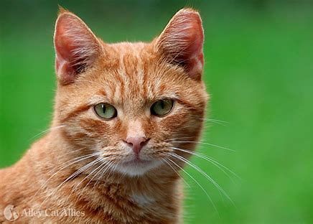

Slide 32
Thank you

